Slide 1
Austin Housing Price Indicators
SuperCoolDataNerds
Chris Reid
Hannah Fan
Evert Lizama
Miko Laforteza
Notes:
Hannah - We are supercooldatanerds

Slide 2
Project Statement
Our project is to uncover patterns in housing prices around Austin. We'll examine relationships between housing prices and initial indicators of “gentrification” including: construction permits, affordable housing inventory, density of parks, and trends in crime rates over the course of the different years; and related questions, as the data admits.
Notes:
Hannah

Slide 3
Gentrification (Definition)
Demographic and physical changes in neighborhoods that bring in wealthier residents, greater investment, and more development
Notes:
Miko
All of our questions are based on this definition
While gentrification as a phenomenon is hard to measure, we’ve reviewed the latest academic research and narrowed it down to these topics
We examine characteristics of areas that are initial indicators that lead towards this trend

Slide 4
Indicators
Housing Prices
Issued Construction/Demolition Permits
Affordable Housing Inventory
Crime
Amount of Parks
Notes:
Chris Median Home Sales Prices
Issued Construction Permits
Affordable Housing Inventory

Slide 5


Data Sources
Data.AustinTexas.Gov
The official City of Austin Data Portal
Open data and information provided by Austin city Government
Most complete datasets
Comprehensive for our specific project
Redfin
Housing price data From Redfin
Direct competitor of Zillow, Trulia, Realtor.com
Only one with open data source
Notes:
Hannah

Slide 6
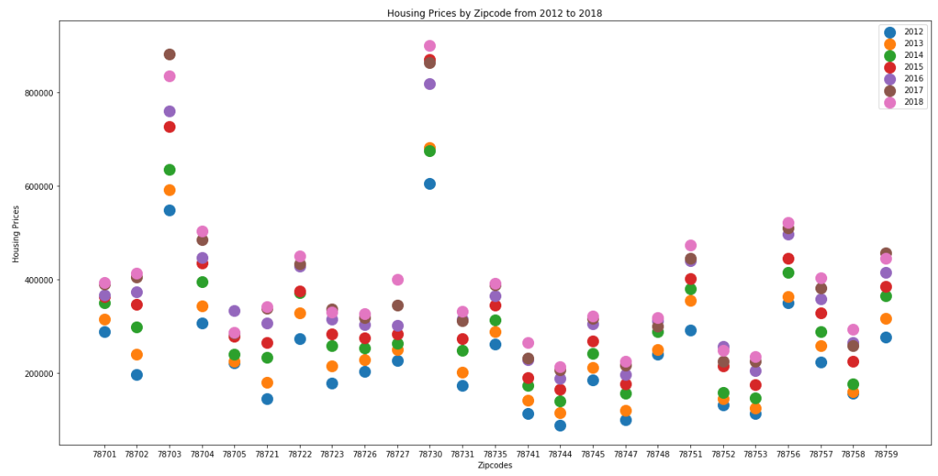
Rise in Housing Prices: 2012 to 2018
Notes:
What was our topic? What were we looking for? Why were we examining this topic?
Each of us give problems that we’ve encountered in cleaning the data
Charts

Slide 7
How does building permits affect housing prices?
Why:
These permits in the aggregate can indicate when the economy is starting to pick up, or precisely where in the city things are improving.
Process:
Looking for specific Zip Codes/Years
Problems:
Large File
Analysis:
Zip Codes with the highest amount of construction permits were the ones with the largest inventory of affordable housing and housing prices
Notes:
What was our topic? What were we looking for? Why were we examining this topic?
Each of us give problems that we’ve encountered in cleaning the data/Data collection Process
Charts

Slide 8
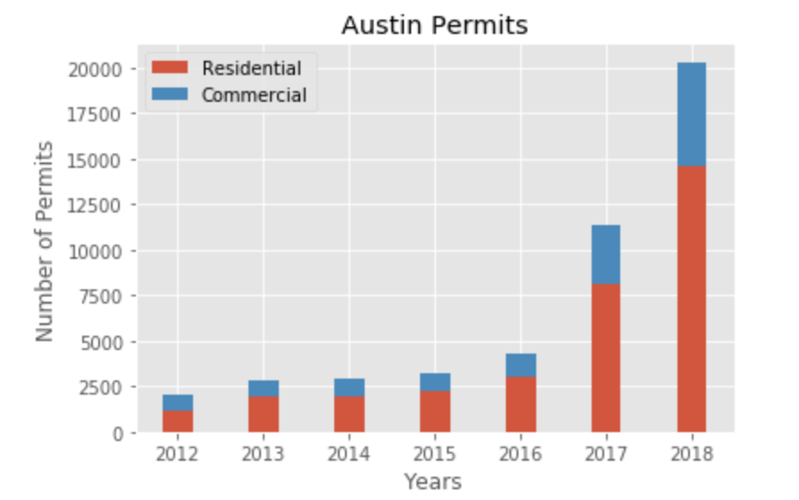
How does building permits affect housing prices?
Notes:
What was our topic? What were we looking for? Why were we examining this topic?
Each of us give problems that we’ve encountered in cleaning the data/Data collection Process
Charts

Slide 9
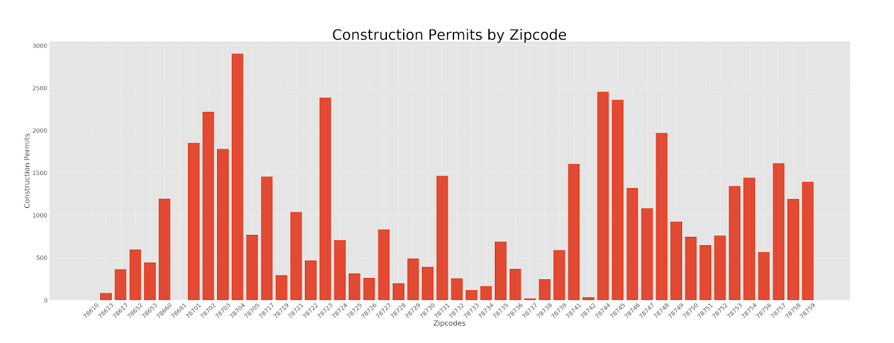
How does issued building permits affect housing prices?

Slide 10
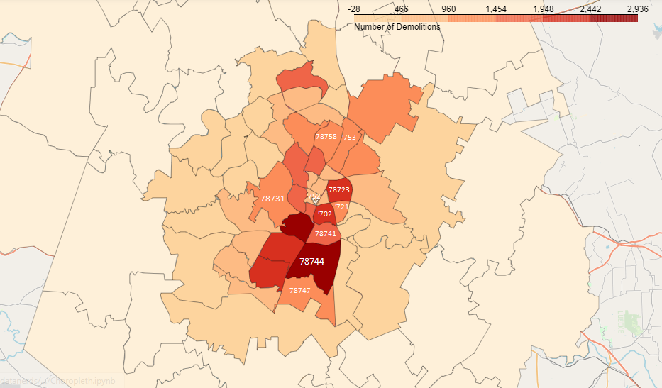


Slide 11
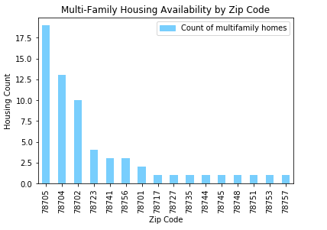
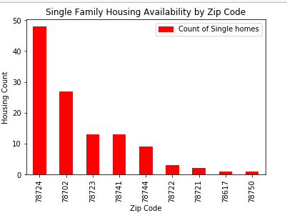
Data Analysis - Housing Availability by ZIP
Notes:
What was our topic? What were we looking for? Why were we examining this topic?
Each of us give problems that we’ve encountered in cleaning the data
Charts
The drastic increase in housing prices correlates with the number of Austin Permits issued
Demos - 78744, 78741, 78702, 78721, 78723, 78753
Rising prices - 78721, 78741, 78744, 78753
So to add to Hannah’s and Mikos point another factor we took into consideration is affordable housing in Austin. The reason being is that affordable housing data can be a good indicator of housing prices relative to the area. In this case, I was responsible for gathering Austin affordable housing inventory that included all income-restricted affordable units in development or completed. For this dataset, my approach I took was first understanding the important data points that could be relevant to our analysis which was the zip code, housing type, and median family income. I then cleaned the dataset to remove rows with missing data such as the zip code. For the first couple of bar graphs, the team and I were able to find a relationship between affordable housing availability by zip codes here that have been marked with the blue box over it. We were able determine that in the areas where the housing affordability was low there was a significant increase in housing pricing as well as building permits which would drive housing affordability down. Another factor that also impacts housing affordability is median family income where I aggregated these amounts which distinguishes the amount of income allocated towards housing. From this pie graph one can say that a lot of income is being allocated towards housing which would support the idea that housing prices are growing.

Slide 12
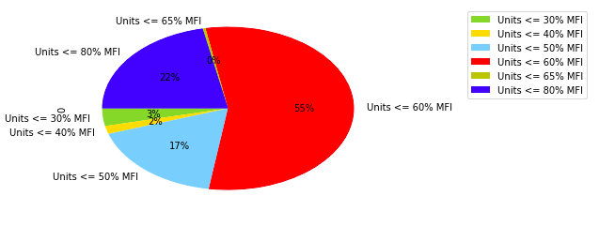
Housing Affordability - Median Family Income

Slide 13
How does the number of parks affect housing prices?

Slide 14
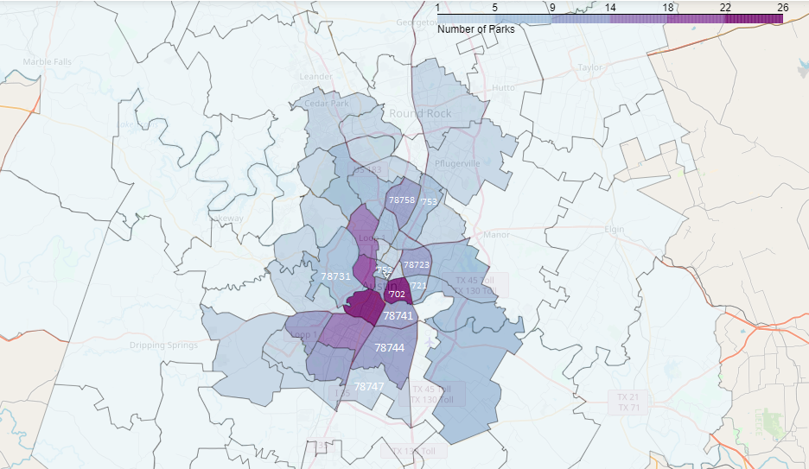
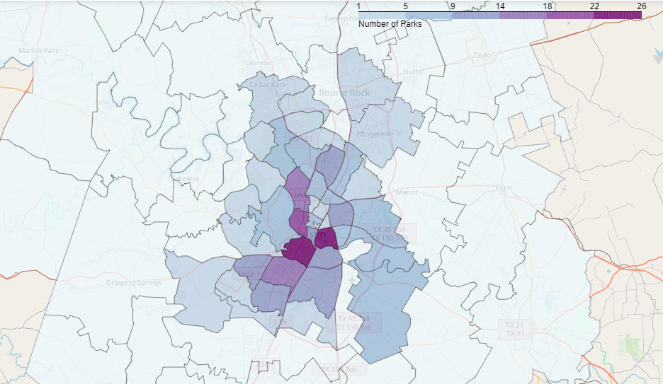
Notes:
I labeled the top ten growth zip codes. We saw that the most movement was near, but not in the zip codes with the most parks.

Slide 15
How does crime affect housing prices?
Notes:
What was our topic? What were we looking for? Why were we examining this topic?
Each of us give problems that we’ve encountered in cleaning the data
Charts

Slide 16
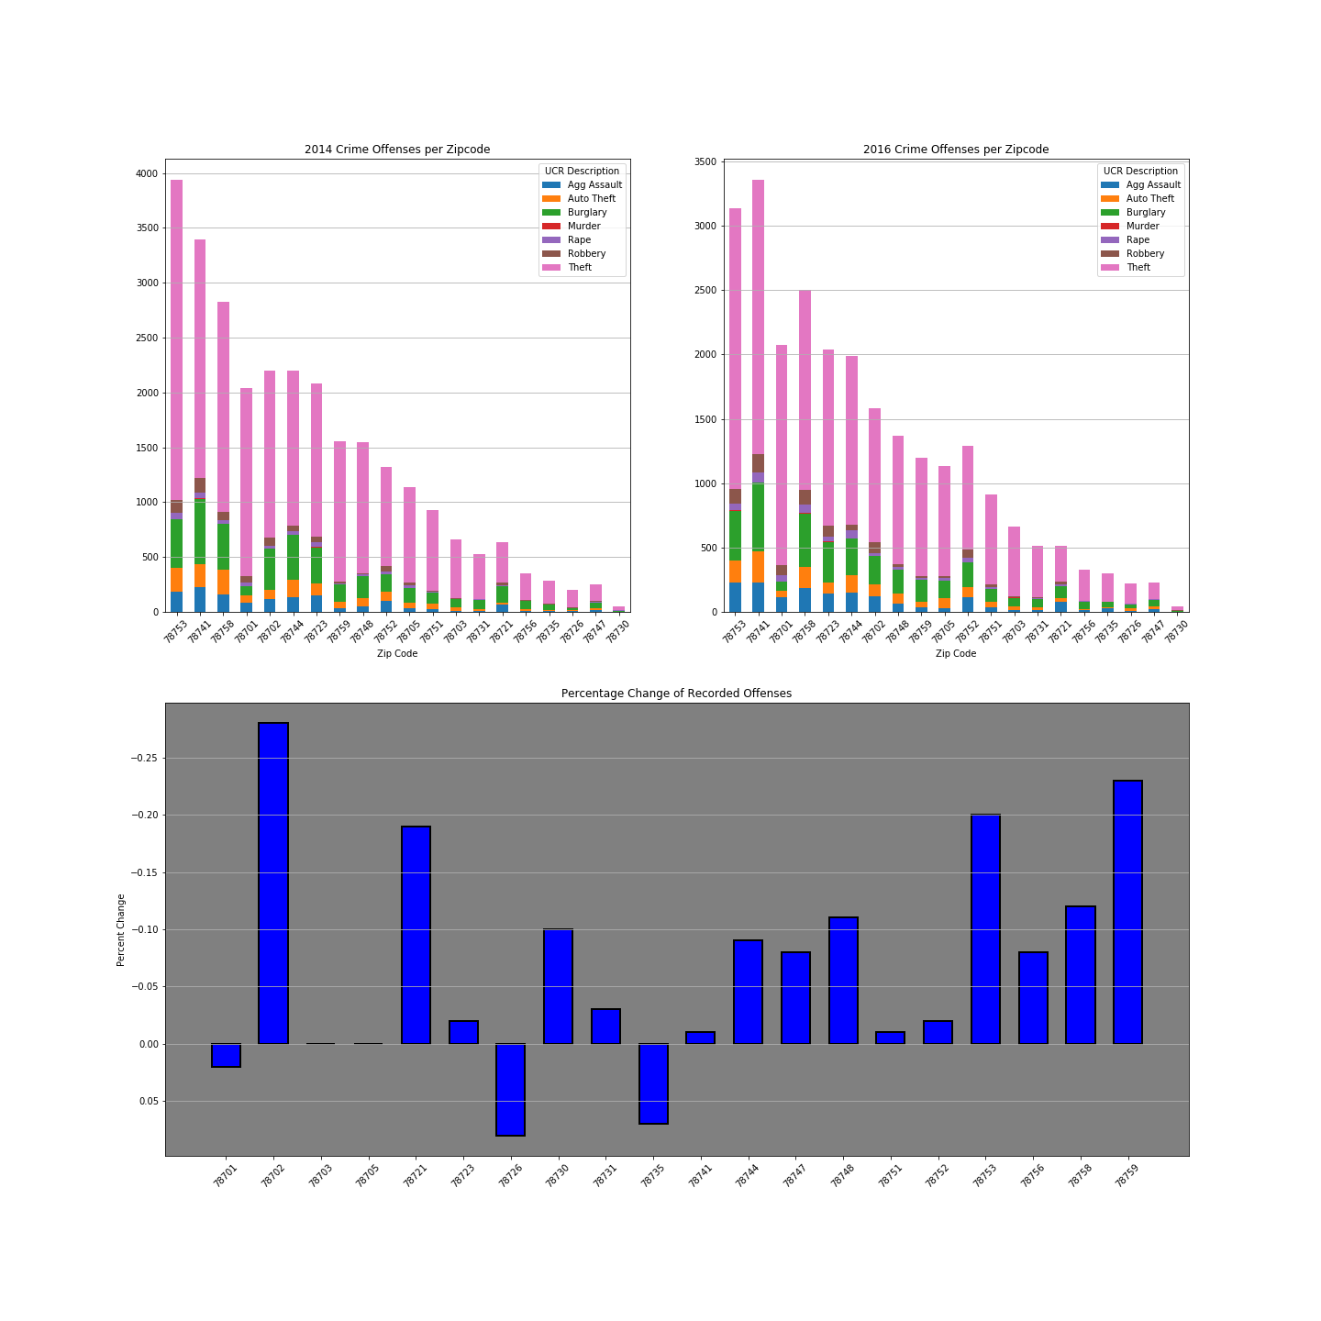
Notes:
Top Left: 2014 by Offense; Top Right 2016 by Offense
Bottom: Percent change with inverted Y axis: You’ll see 78744,78741, 78758

Slide 17
Limitations/Challenges
Missing zip codes data
Missing timeframes/data
No Rental Price Data
Data Integrity
Actual correlation
Time Limitations
Other potential indicators?
Evictions
School Districts
Notes:
Evert
A couple of our datasets only included neighborhood data information so we had to do some manual work to figure zip code based on the neighborhood location. Didn’t actually run regressions or actual corelation functions

Slide 18
Summary
Based on crimes rates, affordable housing, building permits, and park proximity, we evaluated how this could affect housing prices over the years.
Assumptions previous to this assignment were that east Austin would have the highest rise in housing in this time period. They were actually in south central and west Austin.
The largest decrease in crime saw the largest increase in housing price.
Largest number of building permits saw the highest climb in prices.
Available affordable housing dropped in areas with climbing housing prices.
Notes:
Hannah
-The largest rises in housing prices were not exactly in the areas that we expected
-The largest decrease in crime saw the largest increase in housing price (Smaller Amount of Affordable Housing, Above Average Amount of Permits Issued for these specific zipcodes)
-While there isnt direct linear correlation between factors

Slide 19

Questions?

